Slide 1
Sproket Central Pty Ltd
Data Analytics Approach
Manager: Kathleen
Junior Consultant: Ishika Saha

Slide 2
Agenda:
Introduction
Data Exploration
Model Development
Interpretation

Slide 3
Customer Analysis
Customer Age distribution
Gender wise purchases
Availability of Car in each state
Wealth segments
Job industry category

Slide 4
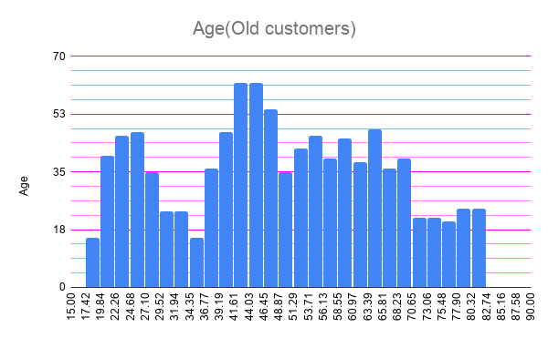
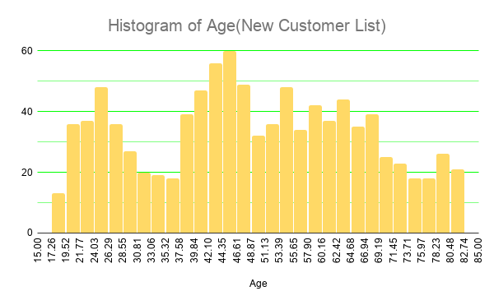
Customer Age distribution
Deductions:
New customers are mostly in the age group 25 to 50 years.
Ages from 30 to 37 and 70 - 77 are almost same.
Highest no.of customers in the age group 44 to 46.

Slide 5
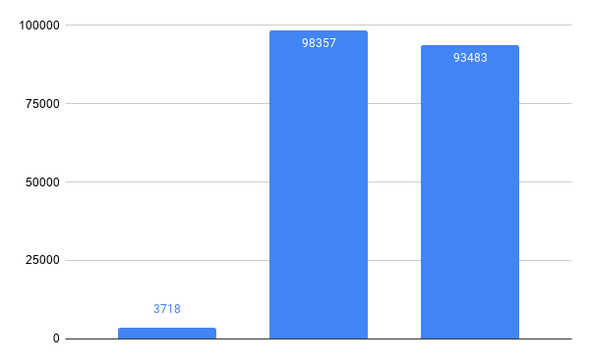
Gender wise purchases
Deductions:
Highest proportion of female customers
Then male
So there should be more focus on the female customers.
Advertise accordingly to attract the female customers

Slide 6
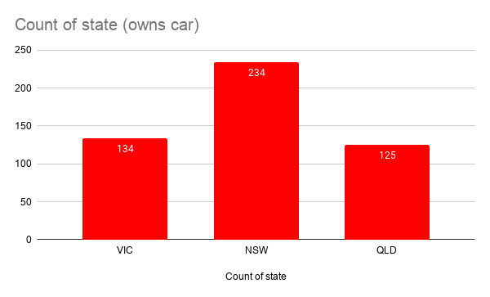
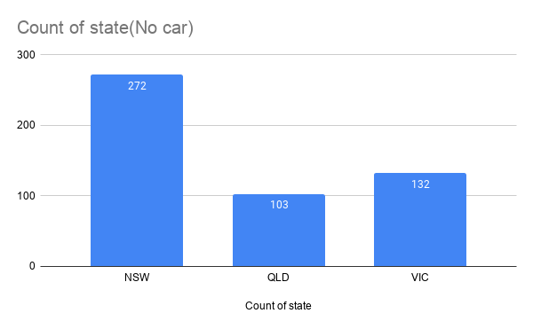
Car availability
Deductions:
NSW has most no. of customers who don’t have car. So focus on them
QLC and VIC have almost same no. of people who owns and don’t own a car.

Slide 7
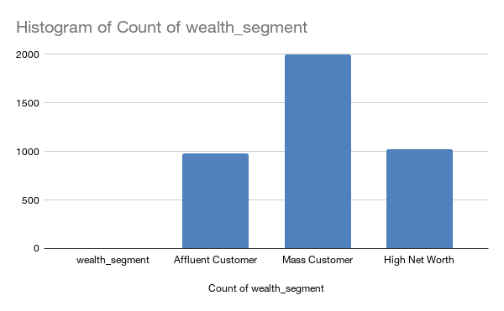
Wealth Segment
Deductions:
Mostly the customers are from the Mass customer class. Focus on them
Next we have High Net Worth
And lastly the Affluent Customer.

Slide 8
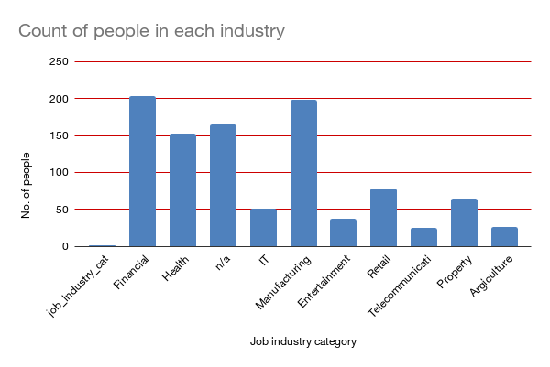
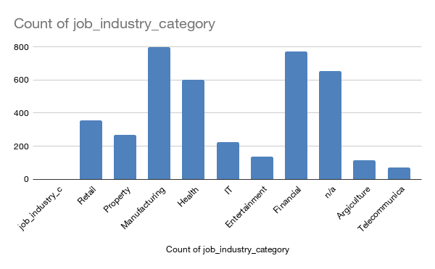
Job industry category
Deductions:
Most of the customers are from the manufacturing and financial sector.
Rest all the sectors have same number.

Slide 9
Appendix

